Slide 1
The Science
Conservation Poster
All 5th grade students at GHE will be competing in the Wake County Science Conservation Poster Contest.
This is a mandatory homework project due Oct. 26th .
The topic this year is:
“Soil and Water: Yours For Life”
All the necessary information is on the class website.

Slide 2
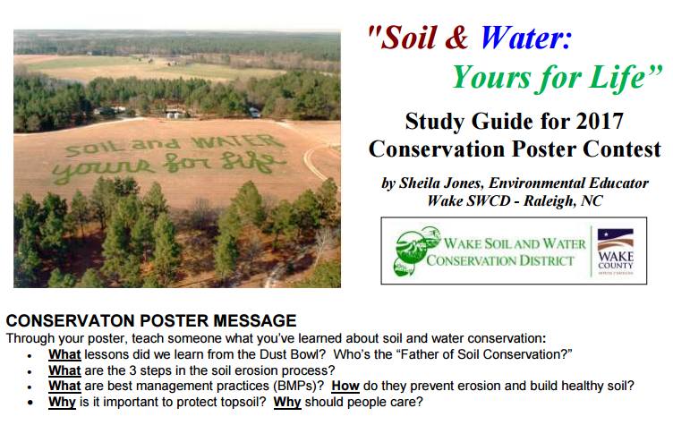
The study guide lists a dozen BMPS. You should focus on just 1 or 2!

Slide 3
The Science
Conservation Poster
3 winning posters will be selected from each classroom by a panel of anonymous judges.
Those 3 posters advance to the next level of competition. The winners of that level receive a cash prize! And continue to advance in the competition.

Slide 4
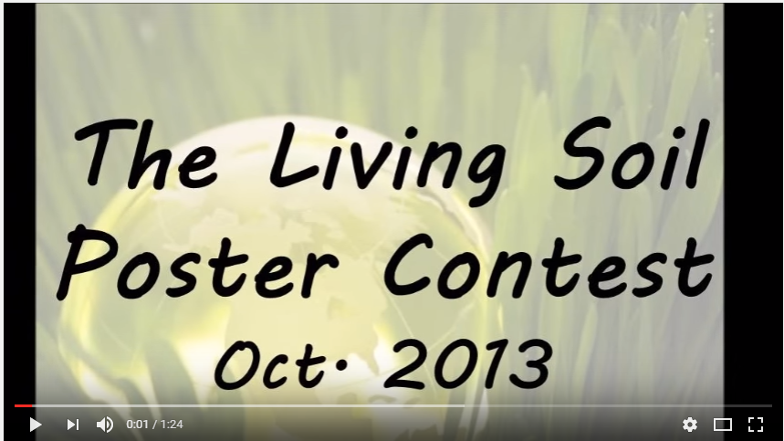
The Science
Conservation Poster
Here are some posters which had a similar theme. Think about which posters you really liked and what the creator did well.
What might an award-winning poster look like?

Slide 5
The Science
Conservation Poster
Hints
Read the Rubric & Information carefully so your poster is not disqualified from the competition!
Make your poster interactive.
Be neat and check your spelling!

Slide 6
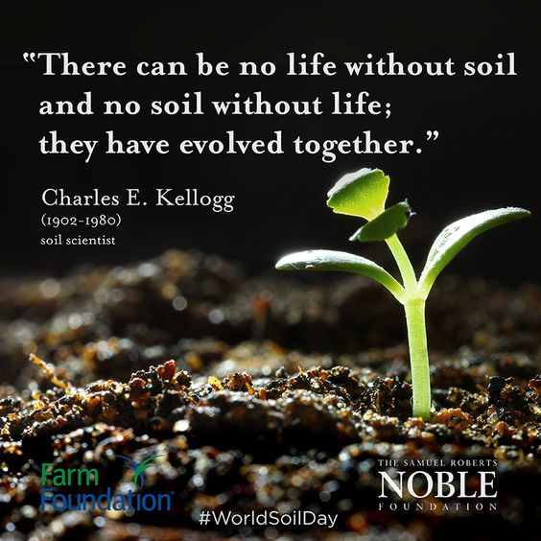
The Science
Conservation Poster
Hints
Winning posters do a great job at balancing science research with original artwork. This can be difficult to do, but by including lift-the-flaps, wheels-that-turn, and panels-that-slide, student artists can "hide" busy text so as not to clutter the poster. These moving parts invite viewers to interact with the poster and learn more!

